Slide 1

Edsamplr: simulating data for statistics instruction
Keah Tandon & Michael A. Seaman

Slide 2
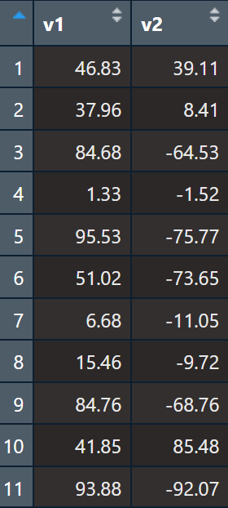
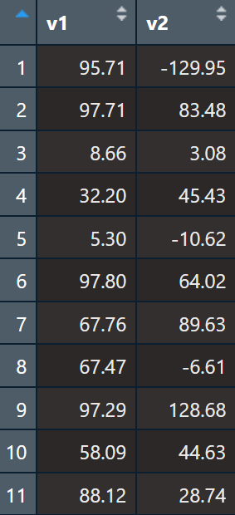
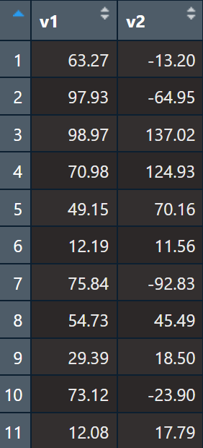
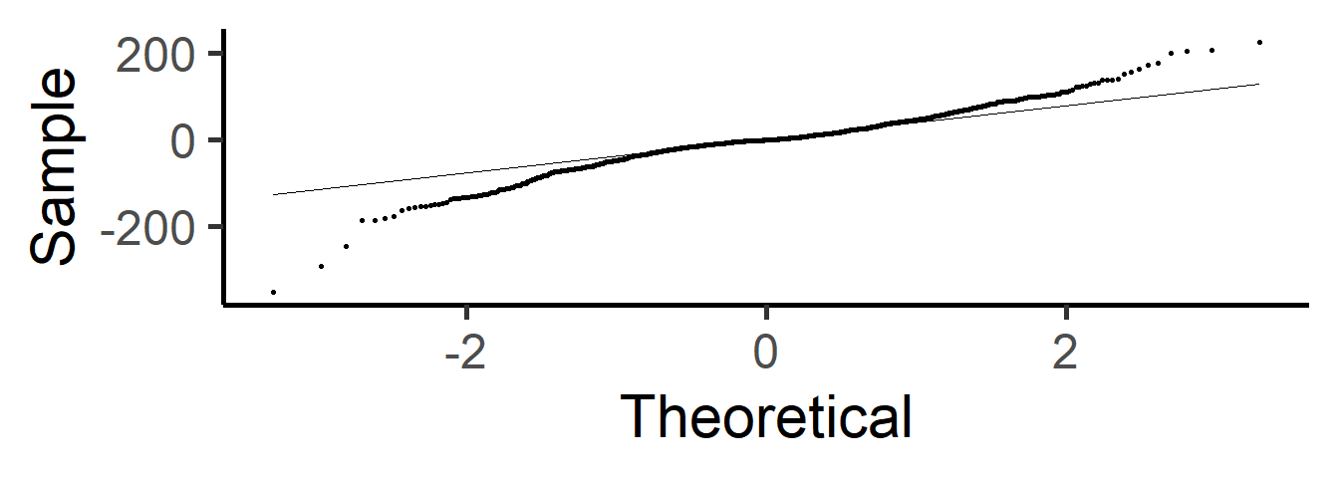
Introduction
The Problem
Students seek quantitative research training
Ideally includes
Real research
Conditions for valid inference
Variety of distributional shapes
Finding data difficult
Data not always available
Need multiple data sets

Slide 3

Features
Technical Details
Data
Categorical
Quantitative
Correlated
Matched pairs
Named distributions
Summary statistics
R package
Uses Headrick’s fifth-order polynomial method

Slide 4
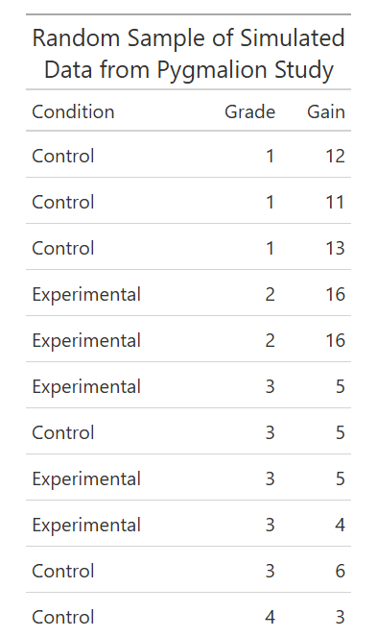
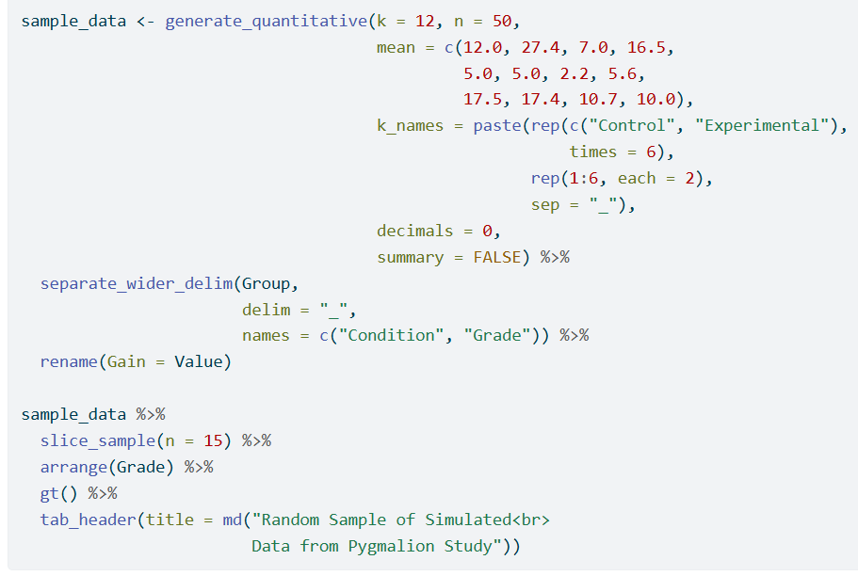
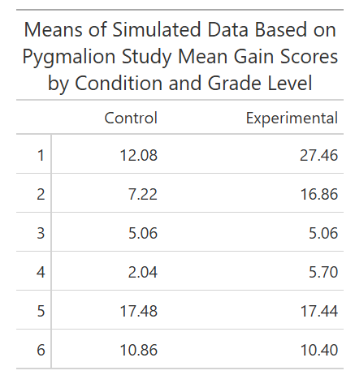
Example
Notes:
For pyg data, just pick one grade

Slide 5
References
Fleishman, A. I. (1978). A method for simulating non-normal distributions. Psychometrika, 43(4), 521-532.
Headrick, T. C. (2002). Fast fifth-order polynomial transforms for generating univariate and multivariate nonnormal distributions. Computational Statistics & Data Analysis, 40, 685-711.
Olvera Astivia, O. L., & Zumbo, B. D. (2015). A cautionary note on the use of the Vale and Maurelli method to generate multivariate, nonnormal data for simulation purposes. Educational and Psychological Measurement, 75(4), 541-567. https://doi.org/10.1177/0013164414548894
Rosenthal, R., & Jacobson, L. (1968). Pygmalion in the classroom. The Urban Review, 3, 16-20.
Keah Tandon
Data Analyst, SAAS Academic Assessment
PhD Student, Educational Psychology and Research
tandonk@mailbox.sc.edu

